Slide 1
Chapter 3
Components in React

Slide 2
Objectives
Introduction React Component
Quick Review of Functions
Changing How We Deal with UI
Meet the React Component

Slide 3
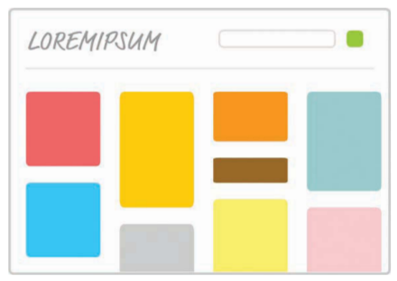
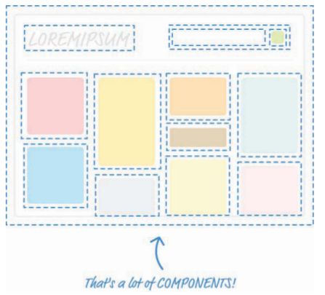
Introduction React Component
Components are one of the pieces that make React, well, React! They’re one of the primary ways you have for defining the visuals and interactions that make up what people see when they use your app

Slide 4
Quick Review of Functions
var speed = 10; var time = 5; alert(speed * time); var speed1 = 85; var time1 = 1.5; alert(speed1 * time1); var speed2 = 12; var time2 = 9; alert(speed2 * time2); var speed3 = 42; var time3 = 21; alert(speed3 * time3);
In a really chill world that involves functions, you can condense all that duplicated text into something simple, like the following: function getDistance(speed, time) { var result = speed * time; alert(result); } getDistance(10,5); getDistance(85,1.5); getDistance(12,9); getDistance(42,21);

Slide 5
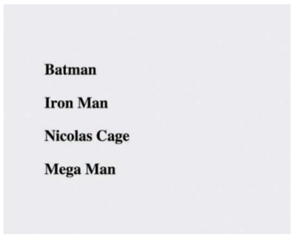
Changing How We Deal with UI
Onscreen, the word Batman printed in giant letters, thanks to the h1 element. Say that we want to print the names of several other superheroes.
var destination = document.querySelector("#container"); ReactDOM.render( <div> <h1>Batman</h1> <h1>Iron Man</h1> <h1>Nicolas Cage</h1> <h1>Mega Man</h1> </div>, destination );

Slide 6
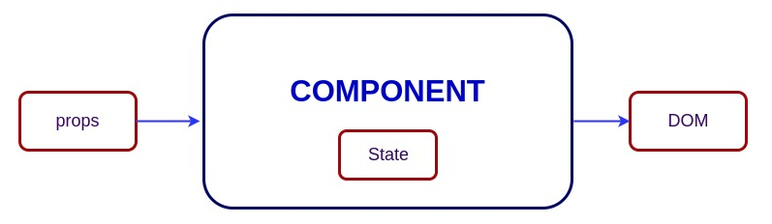
Meet the React Component
The solution to all of our problems can be found in React components. React components are reusable chunks of JavaScript that output (via JSX) HTML elements.

Slide 7
Meet the React Component
<!DOCTYPE html> <html> <head> <meta charset="utf-8"> <title>React Components</title> <script src="https://unpkg.com/react@16/umd/react.development.js"></script> <script src="https://unpkg.com/react-dom@16/umd/react-dom.development.js"></script> <script src="https://unpkg.com/babel-standalone@6.15.0/babel.min.js"></script> </head> <body> <div id="container"></div> <script type="text/babel"> </script> </body> </html>

Slide 8
Creating a Hello, World! Component
Let’s start really simple. We want to use a component to help us print the famous “Hello, world!” text to the screen. As we already know, using just the render method of ReactDOM would give us code that looks as follows:
ReactDOM.render( <div> <p>Hello, world!</p> </div>, document.querySelector("#container") );

Slide 9
Creating a Hello, World! Component
Getting back to our code, we have created a new component called HelloWorld. This is a component because it extends React.Component .
The way you call a component from it is a bit unique. Go ahead and replace the first argument to ReactDOM.render with the following:
class HelloWorld extends React.Component { render() { return <p>Hello, componentized world!</p> } }
ReactDOM.render( <HelloWorld/>, document.querySelector("#container") );

Slide 10
Creating a Hello, World! Component
Let’s go one step further! Instead of having just a single call to HelloWorld , let’s make a bunch of calls. Modify our ReactDOM.render method to now look as follows:
ReactDOM.render( <div> <HelloWorld/> <HelloWorld/> <HelloWorld/> <HelloWorld/> <HelloWorld/> <HelloWorld/> </div>, document.querySelector("#container") );

Slide 11
Specifying Properties
Right now, our component does just one thing. It prints Hello, world! to the screen and only that! That’s the equivalent of having a JavaScript function that looks like this:
Except for one very specific case, that JavaScript function doesn’t seem very useful, does it? To increase the usefulness of this function, we need to modify it to take arguments
function getDistance() { alert("42km"); }
function getDistance(speed, time) { var result = speed * time; alert(result); }

Slide 12
Updating the Component Definition
HelloWorld component is hard-coded to always send out Hello, world! as part of its return value. We first need to change that behavior by having the return statement print out the value passed in by a property. We need a name to give our property
In JSX, if you want something to get evaluated as an expression, you need to wrap that something inside curly brackets.
class HelloWorld extends React.Component { render() { return <p>Hello, {this.props.greetTarget}!</p> } }

Slide 13
Modifying the Component Call
ReactDOM.render( <div> <HelloWorld greetTarget="Batman"/> <HelloWorld greetTarget="Iron Man"/> <HelloWorld greetTarget="Nicolas Cage"/> <HelloWorld greetTarget="Mega Man"/> <HelloWorld greetTarget="Bono"/> <HelloWorld greetTarget="Catwoman"/> </div>, document.querySelector("#container") );
Each HelloWorld call now has the greetTarget attribute, along with the name of a super hero (or equivalent mythical being) that we want to greet.

Slide 14
Dealing with Children
JSX are very similar to regular HTML elements. When wrapped a component inside a div element or specified an attribute and value as part of specifying properties. Just as you can have many HTML elements, your components can have children.
class Buttonify extends React.Component { render() { return( <div> <button type={this.props.behavior}> {this.props.children}</button> </div> ); } }
ReactDOM.render( <div> <Buttonify behavior="submit">SENDDATA</Buttonify> </div>, document.querySelector("#container") );

Slide 15
Conclusion
If you want to build an app using React, you can’t wander too far without having to use a component. Trying to build a React app without using a component is kind of like building a JavaScript-based app without using functions. If this witty video doesn’t convince you that you should learn to embrace components, I don’t know what will except for maybe a future chapter on creating complex components!
Note: If you run into any issues, ask! If you have any questions or your code isn’t running like you expect, don’t hesitate to ask! Post on the forums at https://forum.kirupa.com and get help from some of the friendliest and most knowledgeable people the Internet has ever brought together!

